Slide 1




Introduction to Golang
Part 1
Calistus Igwilo
https://linkedin.com/in/calistus-igwilo
https://twitter.com/CalistusIgwilo

Slide 2
Announcements
MPlease join the 5thwork portal if you haven't
https://5thwork.com/courses/course-v1:NITDA+NITDA0001+2022Q3/about
Join the course Telegram group for announcements
https://t.me/+HzLMWqDbYcBhNTU8
Precourse extended to 31st December, 2022

Slide 3
Why Learn Go?
Code runs fast
Garbage collection
Simpler objects
Conccurency

Slide 4
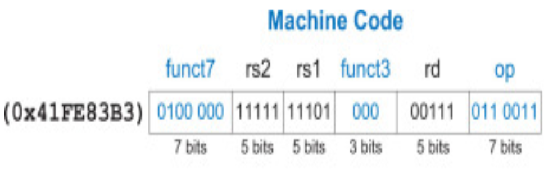
Software Translations
Machine Language
CPU instructions represented in binary
0100 0001 1111 1110 1000 0011 1011 0011 (0x41FE83B3)
The seven least significant bits defines how to interprete the instruction (opcode)

Slide 5
Software Translations
Assembly Language
CPU instructions are represented in mnemonics
instructions, varibles, addresses have names. Example: ADD, SUB, SUM
Eaiser to read
Equivalent to machine language

Slide 6
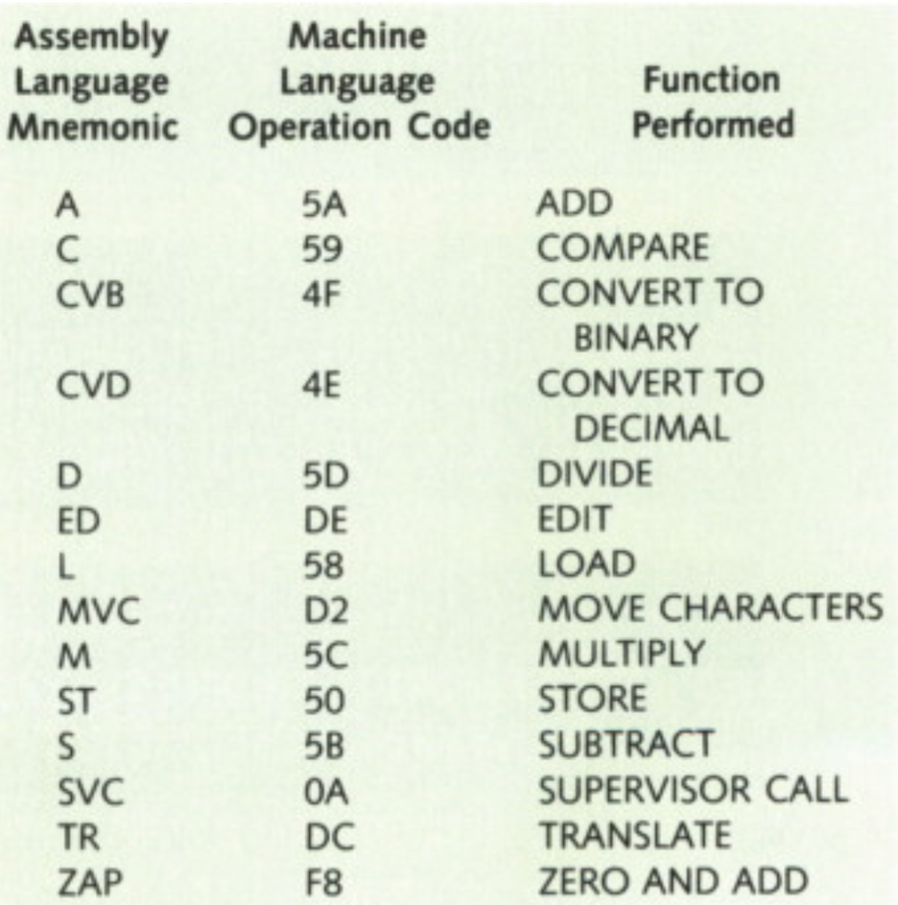
Software Translations
Assembly Language
Harris et al 2022, Digital design and computer architecture

Slide 7
Software Translations
High Level Languge
Much easier to read
Closer to human language
Structured with syntax and semantics to describe the computing algorithm
Examples: C, C++, Python, JavaScript, Go

Slide 8
Compiled Vs Translated
Compilation
Translate instructions once before running the code
Example: C, C++
Saves time, as translation occurs only once

Slide 9
Compiled Vs Translated
Interpretation
Translate instructions while code is executed
Example: Python, JavaScript
Requires an interpreter

Slide 10
Compiled Vs Translated
Demo
Python for interpreter
C for Compiler

Slide 11
Efficiency vs Ease of Use
Compiled code is fast
Interpreters make coding easier
Manage memory automatically
Infer variables
Go is a good compromise

Slide 12
Garbage Collection
Automatic memory management
Where should memory be allocated?
When can memory be dealocated?

Slide 13
Garbage Collection
Memory memory management is hard
Deallocate too early, false memory accesses
Deallocate too late, wasted memory

Slide 14
Garbage Collection
Go includes garbage collection
Typicall done by interpreters

Slide 15
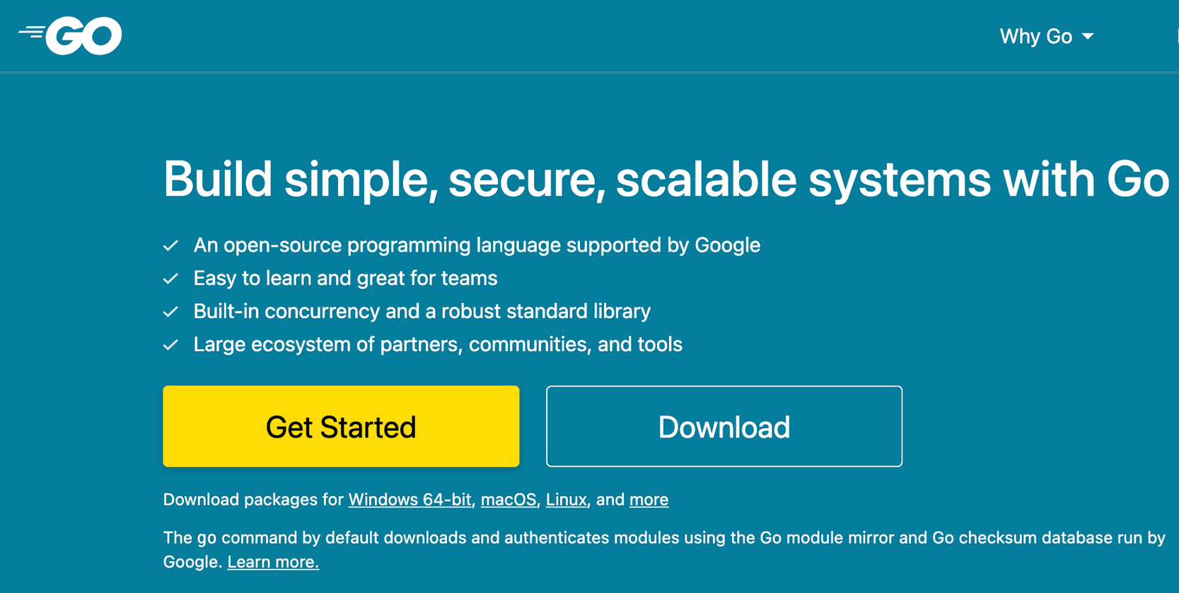
Installing Go
https://go.dev

Slide 16
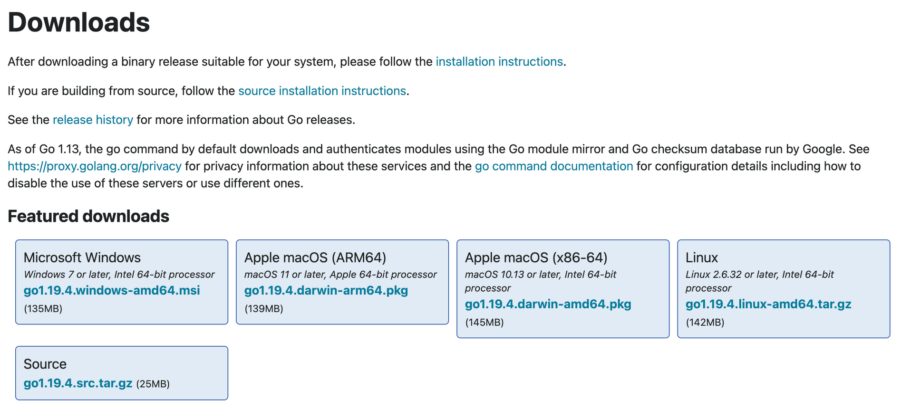
Installing Go

Slide 17
Workspaces
Hierarchy of directories
Common organisation is good for sharing

Slide 18
Workspaces
Three sub-directories
Src - contains source files
pkg - contains packages (libraries)
bin - contains executables
Recommended, not enforced

Slide 19
Packages
Group of related source files
Each package can be imported by other packages
enables software reuse

Slide 20
Packages
First line of code identifies the package
Package calispkg
.
.
Package yusufpkg
.
.
import (
"calispkg"
"yusufpkg
)

Slide 21
Package main
There must be one package called main
Building the main package generates an executable
main package needs a main() function
main() is where exection starts

Slide 22
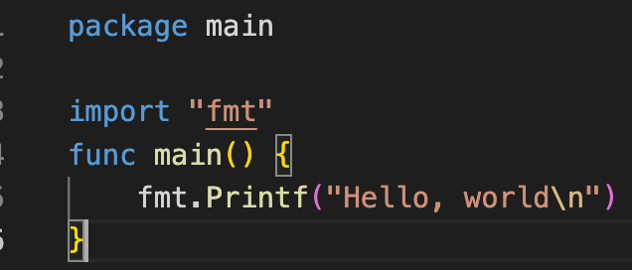
Package main

Slide 23
Go Tool
import
import keyword is used to access other packages
Go standard library includes many packages
fmt
Searches directories specified by GOROOT and GOPATH

Slide 24
Go Tool
go build
Compiles the program
arguements can be a list of packages of go files
creates an executable for the main package
.exe suffix for windows executables

Slide 25
Go Tool
go doc
Prints documentation for the package
go fmt
formats go source files
go get
downloads packages and installs them

Slide 26
Variables
container that holds data in the memory
Naming
Names must start with a letter
Any number of letters, digits, underscores
Case sensitive
Don't use kewords

Slide 27
Variables
Must have a name and a type
Must have declaration
var x int
keyword
name
type
Can declare many on the same line
var x, y, int

Slide 28
Variables Types
Types defines the values a variable might take and the operations that can be performed on it.
Integer
Only integral values
Integer arithmetic (+, -, *, ...)
floating point
Fractional decimal values
floating point arithmetic (+, -, *, ...)

Slide 29
Variables Types
Strings
Bytes, character, sequences
String comparison, search concat, etc
Boolean
true or false

Slide 30
Variables Initialization
Initialize in the declaration
var int = 0;
Initialize after declaration
var x int
x = 0
Unitialized variables gets 0 for its type
var x int // x = 0
var x string // x = ""

